Slide 1
§2 Discrete-Time Signals In the Time-Domain
Outline
The time-domain representation of discrete-time signals
Operations on sequences
Classification of Sequences
Typical sequences
The Sampling Process

Slide 2
§2 Discrete-Time Signals In the Time-Domain
2.1 Time-Domain Representation
Discrete-time signal may also be written as a sequence of numbers inside braces:
{x[n]}={…, -0.2, 2.2, 1.1, 0.2, -3.7, 2.9,…}
↑
n = 0
In the above, x[-1]= -0.2, x[0]=2.2, x[1]=1.1, etc.
values of argument n defined only for integer and undefined for noninteger values of n

Slide 3
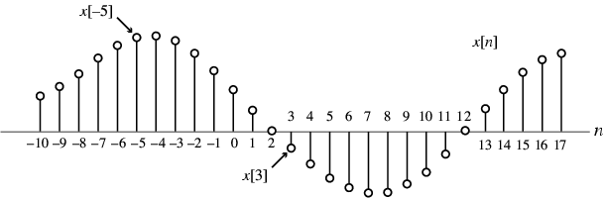
§2 Discrete-Time Signals In the Time-Domain
Graphical representation of a discrete-time signal with real-valued samples is as shown below:

Slide 4
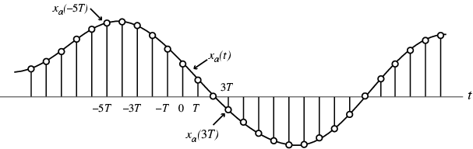
§2 Discrete-Time Signals In the Time-Domain
In some applications, a discrete-time sequence {x[n]} may be generated by periodically sampling a continuous-time signal x_{a}(t) at uniform intervals T of time
Whether or not the sequence {x[n]} has been obtained by sampling, the quantity x[n] is called the n-th sample of the sequence

Slide 5
§2 Discrete-Time Signals In the Time-Domain
Here, n-th sample is given by
x[n]=x_{a}(t) |_{t=nT}=x_{a}(nT), n=…,-2,-1,0,1,…
The spacing T between two consecutive samples is called the sampling interval or sampling period
Reciprocal of sampling interval T, denoted as F_{T} , is called the sampling frequency:
F_{T}=1/T
Unit of sampling frequency is cycles per second, or hertz (Hz), if T is in seconds
MOOC

Slide 6

§2 Discrete-Time Signals In the Time-Domain
Two types of discrete-time signals:
- Sampled-data signals in which samples are continuous-valued
- Digital signals in which samples are discrete-valued
Signals in a practical digital signal processing system are digital signals obtained by quantizing the sample values either by rounding or truncation

Slide 7
§2 Discrete-Time Signals In the Time-Domain
{x[n]} is a real sequence, if the n-th sample x[n] is real for all values of n; Otherwise, {x[n]} is a complex sequence
A complex sequence {x[n]} can be written as
{x[n]}={x_{re}[n]} + j{x_{im}[n]}
where x_{re}[n] and x_{im}[n] are the real and imaginary parts of x[n]
The complex conjugate sequence of {x[n]} is given by
{x*[n]}={x_{re}[n]} - j{x_{im} [n]}

Slide 8
§2 Discrete-Time Signals In the Time-Domain
Example - {x[n]}={cos0.25n} is a real sequence
{y[n]}={e^{j0.3n}} is a complex sequence
We can write
{y[n]}={cos0.3n + jsin0.3n}
= {cos0.3n} + j{sin0.3n}
where {y_{re}[n]}={cos0.3n}
{y_{im}[n]}={sin0.3n}
{y*[n]}={cos0.3n} - j{sin0.3n}

Slide 9
§2 Discrete-Time Signals In the Time-Domain
2.1.1 Length of a discrete-time signal
A discrete-time signal may be a finite-length or an infinite-length sequence
Finite-length (also called finite-duration or finite-extent) sequence is defined only for a finite time interval:
N₁≤ n ≤ N₂
where - ∞< N₁ and N₂ < ∞ with N₁≤ N₂
Length or duration of the above finite-length sequence is N= N₂ - N₁+ 1
Zero-padding—append with zero-valued samples.
x[n]=[x[0] x[1] … x[N-1]]
Vector form
^{t}

Slide 10
§2 Discrete-Time Signals In the Time-Domain
A right-sided sequence x[n] has zero-valued samples for n < N₁
A right-sided sequence
If N₁≥ 0, a right-sided sequence is called a causal sequence.

Slide 11
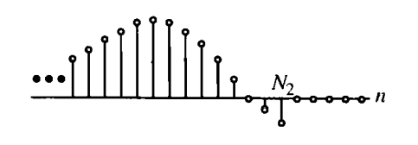
§2 Discrete-Time Signals In the Time-Domain
A left-sided sequence x[n] has zero-valued samples for n > N₂
A left-sided sequence
If N₂≤ 0, a left-sided sequence is called a anticausal sequence.

Slide 12
§2 Discrete-Time Signals In the Time-Domain
2.1.2 Strength of a Discrete-Time Signal
The strength of a DT Signal usually is given by its norm.
of {x[n]} is defied by
p is a positive integer.
In practice, the value of p used is typically 1 or 2 or

Slide 13
§2 Discrete-Time Signals In the Time-Domain
Peak absolute value
For a length-N seqence,
is the root-mean-squared(rms) value of {x[n]}, and
is the mean absolute value of {x[n]}.
It can be shown that
M-file in MATLAB
norm(x,1)
norm(x,2)
norm(x,inf)

Slide 14
§2 Discrete-Time Signals In the Time-Domain
One application of the norm is in estimating the error in approximation of a DT signal by another DT signal
For example, a length-N seqence y[n], and x[n],
0≤ n ≤N-1
mean-squared error(MSE)
relative error

Slide 15
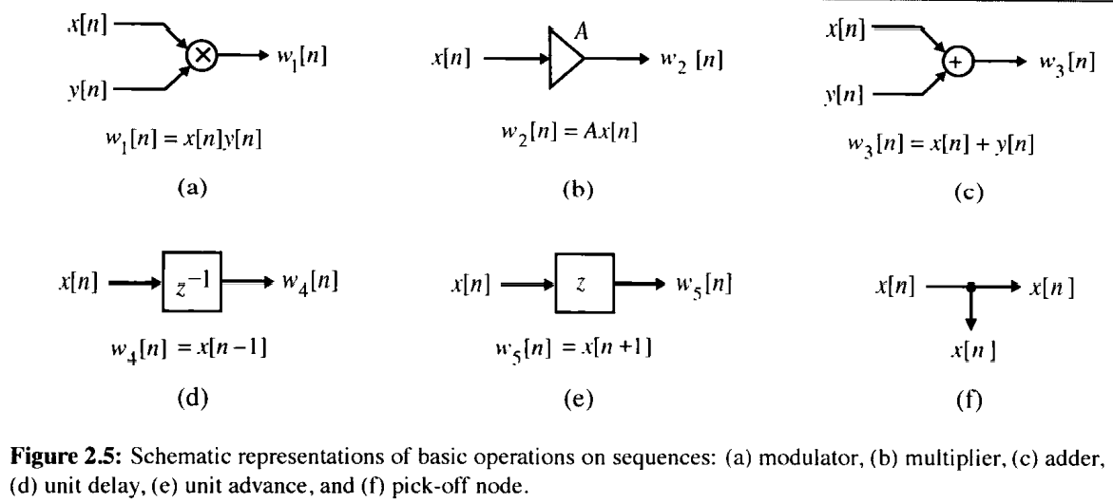
§2 Discrete-Time Signals In the Time-Domain
2.2.1 Elementary Operations
MOOC
time-reversal (folding operation)
x[-n]

Slide 16
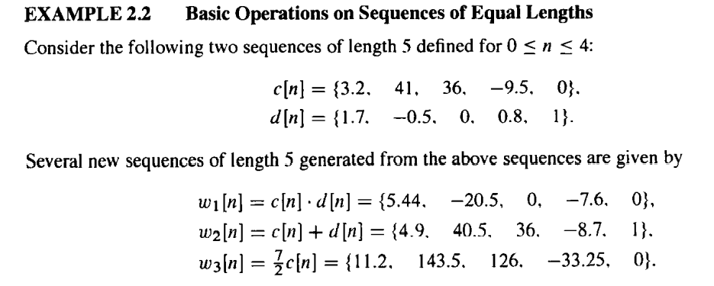

Slide 17
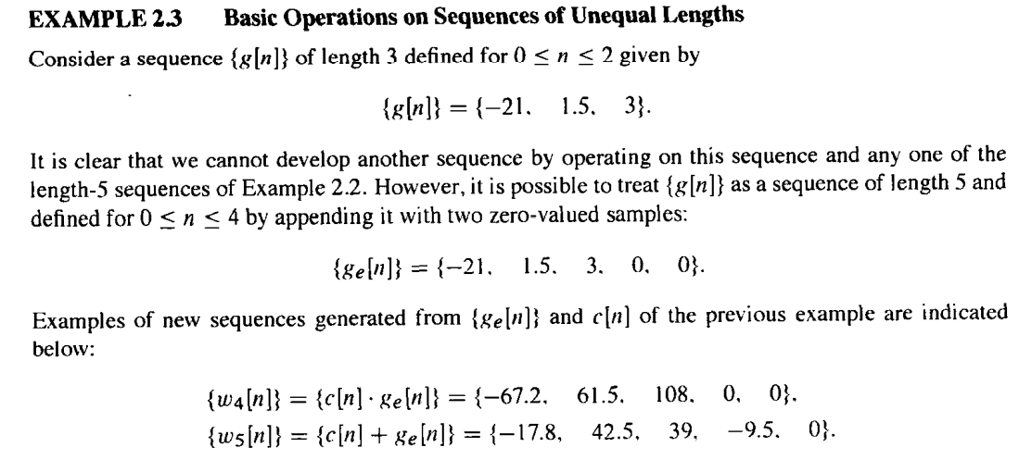

Slide 18
§2 Discrete-Time Signals In the Time-Domain
Example 2.1 Ensemble average
original uncorrupted data
Noise

Slide 19
t
Vector form
S = [s[0] s[1] … s[N-1]]
The i-th measurement of data vector
Ensemble average

Slide 20
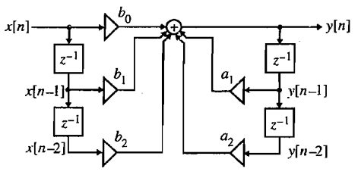
§2 Discrete-Time Signals In the Time-Domain
2.2.2 Combination of Elementary Operations

Slide 21
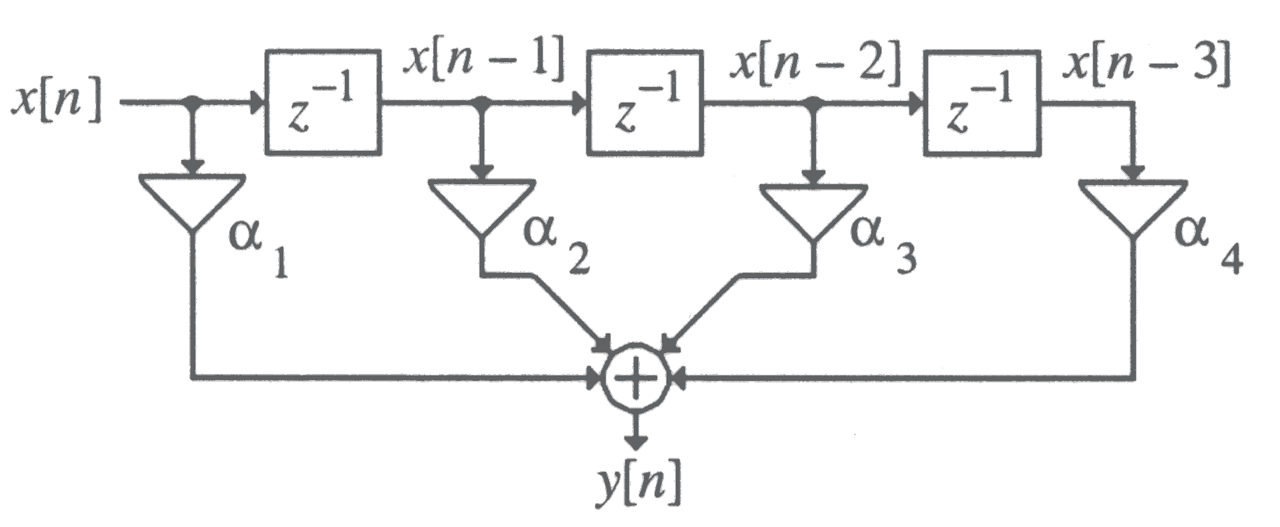
Example
y[n]=α₁x[n]+ α₂x[n-1]+ α₃[n-2]+ α₄x[n-3]
If α₁=α₂=α₃=α₄=1/4, y[n]=1/4{x[n]+ x[n-1]+ [n-2]+x[n-3]

Slide 22
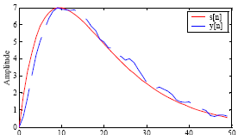
M-point moving-average system
Ex：x[n] = s[n] + d[n]
s[n] = 2[n(0.9)^{n} ], d[n] - random signal

Slide 23
2.2.3 Convolution Sum
§2 Discrete-Time Signals In the Time-Domain
is called the convolution sum of the sequences x[n] and h[n] and represented compactly as
y[n] = x[n] h[n]
*
if the lengths of the two sequences being convolved are M and N, then the sequence generated by the convolution is of length M+N-1
MOOC

Slide 24
Convolution Sum Properties
§2 Discrete-Time Signals In the Time-Domain
Commutative property:
x[n] h[n] = h[n] x[n]
*
*
Associative property :
(x[n] h[n]) y[n] = x[n] (h[n] y[n])
*
*
*
*
Distributive property :
x[n] (h[n] + y[n]) = x[n] h[n] + x[n] y[n]
*
*
*

Slide 25
§2 Discrete-Time Signals In the Time-Domain
Example Develop the sequence y[n] generated by the convolution of the sequences x[n] and h[n] :
x[n] = h[n] = δ[n] + δ[n-1] + δ[n-2]
*
y[n]=δ[n]+2δ[n-1]+3δ[n-2]+2δ[n-3]+δ[n-4]
y[n ]
3
2
2
MOOC
1
1
n
0
1
2
3
4

Slide 26
§2 Discrete-Time Signals In the Time-Domain
x[n] = h[n] = δ[n] + δ[n-1] + δ[n-2]
x[k]
x[k]
x[k]
x[k]
x[k]
x[k]
1
h[k]
h[-k]
h[1-k]
h[2-k]
h[3-k]
h[4-k]
1
X[k]h[-k]
X[k]h[1-k]
X[k]h[2-k]
X[k]h[3-k]
X[k]h[4-k]
k
k
k
k
k
MOOC
∑X[k]h[-k]
=1
∑X[k]h[1-k]
=2
∑X[k]h[2-k]
=3
∑X[k]h[3-k]
=2
∑X[k]h[4-k]
=1

Slide 27
Tabular Method of Convolution Sum Computation
Example: We want to obtain the convolution sum y[n] by the following steps:
n: 0 1 2 3 4 5
g[n]: g[0] g[1] g[2] g[3]
h[n]: h[0] h[1] h[2]
g[0]h[0] g[1]h[0] g[2]h[0] g[3]h[0]
g[0]h[1] g[1]h[1] g[2]h[1] g[3]h[1]
g[0]h[2] g[1]h[2] g[2]h[2] g[3]h[2]
y[n]: y[0] y[1] y[2] y[3] y[4] y[5]

Slide 28
Example: x[n]=(1/2)^{n-2}μ[n-2]
h[n]= μ[n+2]

Slide 29
2.2.4 Sampling rate alteration
§2 Discrete-Time Signals In the Time-Domain
Up-sampling
Down-sampling
MOOC

Slide 30
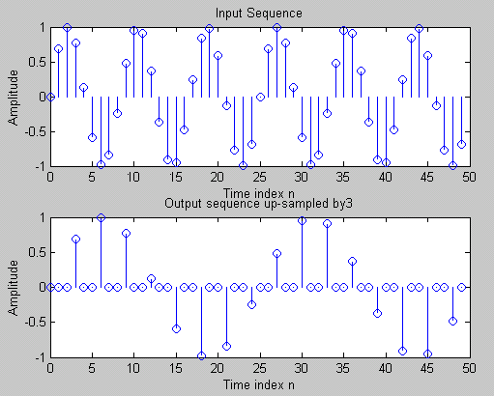
§2 Discrete-Time Signals In the Time-Domain
MOOC
Up-sampling (L=3)

Slide 31
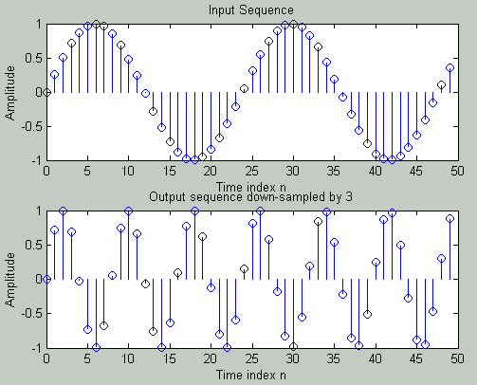
§2 Discrete-Time Signals In the Time-Domain
MOOC
Down-sampling (M=3)

